Slide 1
Structured Exception Handling
Dong Jia

Slide 2
Questions
Why access violation is reported as 0xC0000005?
What is the differences between the exception and error code?
What is the benefits if I use the exception?
What is unhandled exception? Can I handle it?

Slide 3
Agenda
Termination Handler
Exception Handler
Unhandled Exception Handler

Slide 4
Termination Handler
/* Termination Handler */
__try
{
// Guarded body
}
__finally
{
// Termination Handler
}

Slide 5
Termination Handler
Sample

Slide 6
Termination Handler
When Termination handler is called
Normal flow of control from the try block into the finally block
Local unwind: premature exit from the try block (goto, longjump, continue, break, return, and so on) forcing control to the finally block
Global unwind

Slide 7
Termination Handler
Local unwind introduce performance punishment
__leave

Slide 8
Termination Handler
Rule
AVOID any statements that would cause a premature exit
Use __try/__finally and try/catch correspondingly

Slide 9
Exception Handler
/* Exception handler */
__try {
// Guarded body
}
__except (exception filter) {
// Exception handler
}

Slide 10
Exception Handler
VALUE | MEANING
EXCEPTION_EXECUTE_HANDLER | Exception is expected; Exception handler is executed; 1st instruction after Exception handler is executed;
EXCEPTION_CONTINUE_SEARCH | Exception is unexpected and will be handled by upper exception handler or become a unhandled exception; Exception handler isn’t executed; Upper exception handler or unhandled exception handler is executed;
EXCEPTION_CONTINUE_EXECUTION | Exception is expected; Exception handler is executed; Original instruction is executed;

Slide 11
Exception Handler
Sample

Slide 12
Exception Handler
__try {
A;
}
__except (filter)
{
B;
}
__finally
{
C;
}
__try {
A;
}
__except (filter1)
{
B;
}
__except (filter2)
{
C;
}
__try {
__try {
A;
}
__finally {
B;
}
}
__except (filter)
{
C;
}
__try {
__try {
A;
}
__except (filter)
B;
}
}
__finally {
{
C;
}

Slide 13
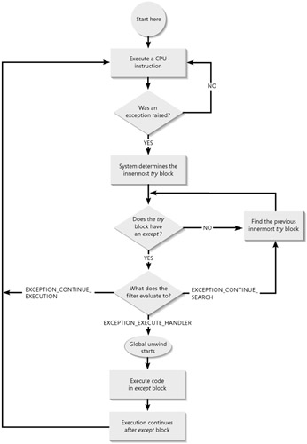
Exception Handler
Exception process

Slide 14
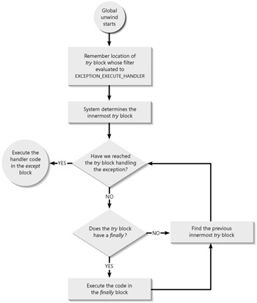
Exception Handler
Global unwind

Slide 15
Exception Handler
Exception Code
EXCEPTION_ACCESS_VIOLATION
EXCEPTION_STACK_OVERFLOW
EXCEPTION_BREAKPOINT
EXCEPTION_INT_DIVIDE_BY_ZERO

Slide 16
Exception Handler
Exception Code Rule
Bits | 31–30 | 29 | 28 | 27–16 | 15–0
Contents | Severity | M/C | Reserved | Facility code | Exception code
Meaning | 0=Success 1=Informational 2=Warning 3=Error | 0=M 1=C | 0 | The first 256 values are reserved by Microsoft | Microsoft/customer defined code
Facility Code | Value
FACILITY_NULL | 0
C 0 0 0 0 0 0 5 (hexadecimal)
1100 0000 0000 0000 0000 0000 0000 0101 (binary)

Slide 17
Unhandled Exception Handler
Sample

Slide 18
Unhandled Exception Handler
VOID BaseThreadStart(PTHREAD_START_ROUTINE pfnStartAddr, PVOID pvParam)
{
__try {
ExitThread((pfnStartAddr)(pvParam));
}
__except (UnhandledExceptionFilter(GetExceptionInformation())) {
ExitProcess(GetExceptionCode());
}
// NOTE: We never get here
}

Slide 19
Unhandled Exception Handler
Inside the UnhandledExceptionFilter Function
Allowing Write Access to a Resource and Continuing Execution
Notifying a Debugger of the Unhandled Exception
Notifying Your Globally Set Filter Function
Notifying a Debugger of the Unhandled Exception (Again)
Silently Terminating the Process

Slide 20
Unhandled Exception Handler
Unhandled exception handler is per thread
Always return
EXCEPTION_EXECUTE_HANDLER
EXCEPTION_CONTINUE_EXECUTION
EXCEPTION_CONTINUE_SEARCH
The best place to dump the process

Slide 21
Q&A

